Slide 1




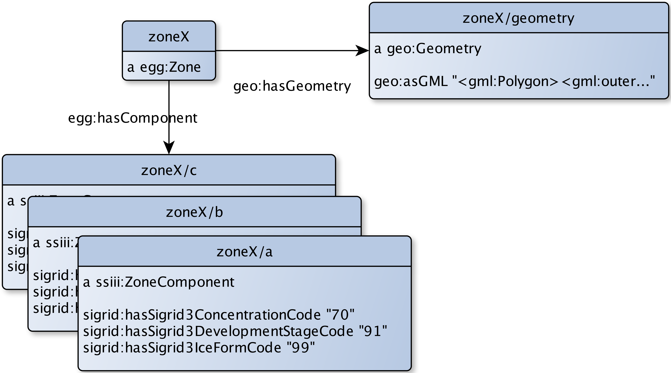
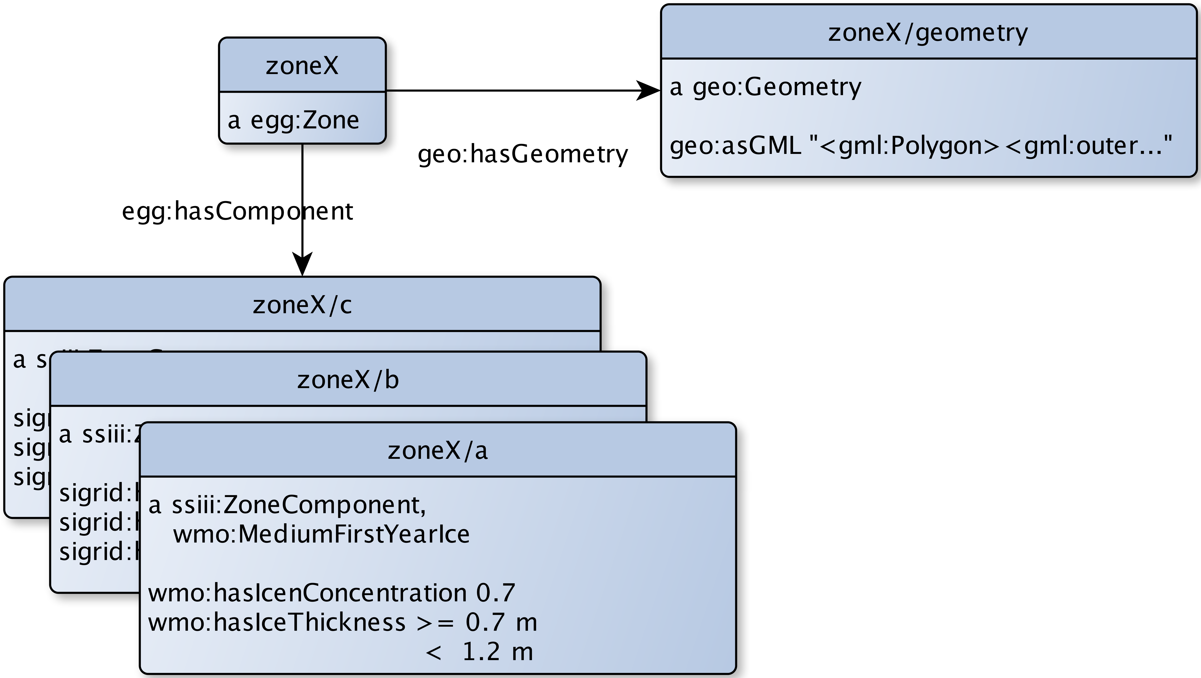

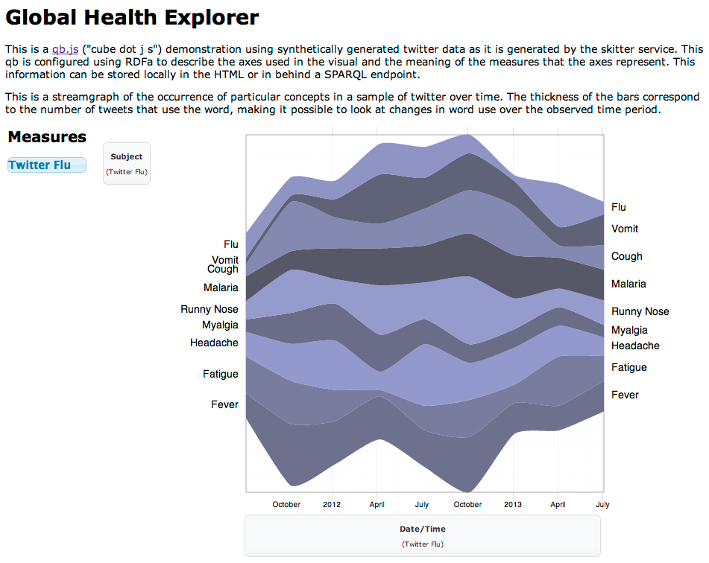

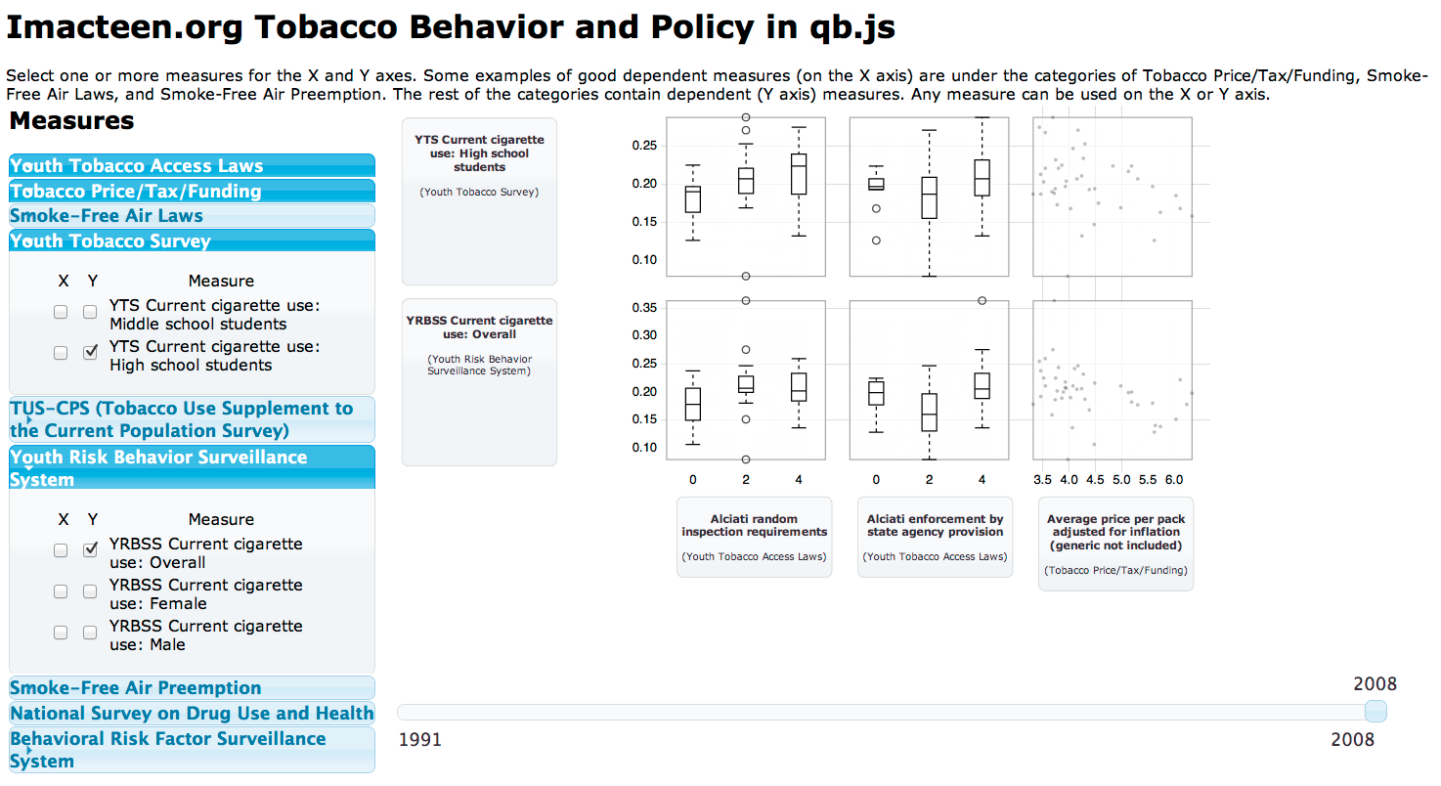
IN51C-1702
Northern Hemisphere Sea Ice Extent and Concentration (Feb. 17, 2003)
Exploring Sea Ice Composition Using Semantic Data Dictionaries and qb.js
James P. McCusker^{1 (mccusj@rpi.edu)}, Ruth E. Duerr^{2 (rduerr@nsidc.org)}, Siri-Jodha Singh Khalsa² ^{(sjsk@nsidc.org)}, Peter L Pulsifer^{2 (pulsifer@nsidc.org)}, Mark A Parsons^{2 (parsonsm@nsidc.org)}, Peter Arthur Fox^{1 (foxp@rpi.edu)}, Deborah L McGuinness^{1 (dlm@cs.rpi.edu)}
Rensselaer Polytechnic Institute 110 8th St., Troy, NY, 12180 United States
National Snow and Ice Data Center, CIRES, 449 UCB, University of Colorado, Boulder, CO 80309 United States
ABSTRACT
Sea Ice is a fundamental component of the Earth system that is undergoing rapid change. Yet sea ice data are described in myriad different, even unique, formats and representations. We show how the Sea Ice Grid (SIGRID) 3 data format and other representations of sea ice concentrations, age, and thickness based on the World Meteorological Organization (WMO) “egg code” can be easily mapped into multidimensional data. The data can then be readily projected onto commonly available geographic mapping tools in a multidimensional analysis environment. Our analysis environment, qb.js, uses Semantic Web standards and Semantic Data Dictionaries, a mixture of multiple ontologies, to provide a data exploration and visualization environment. Geographic and temporal extent are expressed as dimensions of sea ice, while concentrations, age, and thickness as measures of the ice. These dimensions and measures are rendered into a Resource Description Framework (RDF) graph that is described using a Semantic Data Dictionary. This tool will allow users to easily see and understand changes in sea ice extent over many years.
What if we could compute the best path through the Northwest Passage?
We would need to know:
Ice concentration
Ice thickness
Ice form
every step along the way.
Now we know it.
SIGRID3 to Egg Code and WMO Semantics
WMO, SIGRID3, and Egg Code Ontologies
Rendered using d3.js in Google Chrome
Backed by simplified national borders/coasts
Data retrieved from fuseki SPARQL endpoint
Uses GML shapes embedded in GeoSPARQL Geometry objects
Converted from SIGRID 3 SHP data files
Available measures for display:
Sea Ice Concentration (shown)
Sea Ice Development (age)
Sea Ice Form
Available display modalities:
Color/gradient fill and opacity
Multiple datasets can be joined for change over time
Sponsors:
National Science Foundation
Next Steps
Incorporation into qb.js for:
Aggregation and display through time:
Day to day
This time each season
Comparison between different data sources
Compute cross sections through regions for best shipping paths.
Get the poster at
Glossary:
RPI – Rensselaer Polytechnic Institute
TWC – Tetherless World Constellation at Rensselaer Polytechnic Institute
NSIDC – National Snow and Ice Data Center
SSIII– Semantic Sea Ice Interoperability Initiative
OWL – Web Ontology Language
GeoSPARQL – Observation and Measurements
qb.js visualizations
Acknowledgments:
Simon Cox
W3C Provenance Working Group
http://bit.ly/TDweMl

